Slide 1


Smart Car Parking System
PRESENTED BY-
MAISHA HOSSAIN (15301096)
FARIHA SAZID SEJUTI (15101027)
ROWSHNI TASNEEM USHA (15301082)
12/11/2018
FALL 18_DIGITAL SYSTEM DESIGN LABORATORY_SEC2
1

Slide 2
Introduction
Purpose
Build a user friendly and adaptable system in order to alleviate parking hassles
Allow the drivers to accommodate a parking slot without any interference of any other vehicles.
Enhance the security with simplifying parking system

Slide 3
Features
Our proposed system includes the following features:
Auto gate opening
Auto detection of car presence
Detection of whether parking lot empty or occupied
Provides the number of available parking slots in the display
Calculation of the parking bill
Integrate App based parking finder

Slide 4
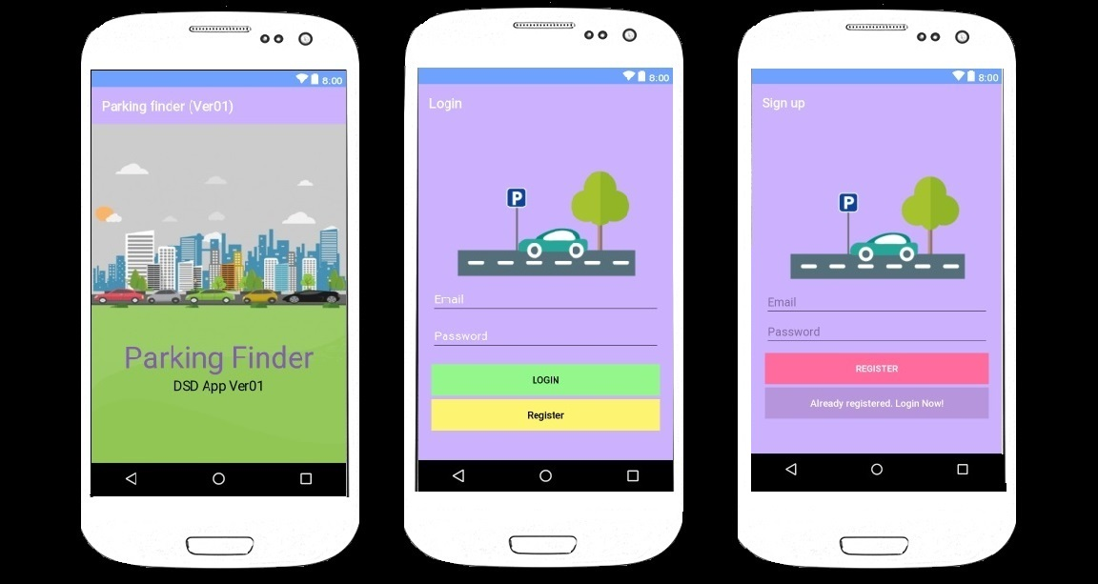
Software: Android Application

Slide 5
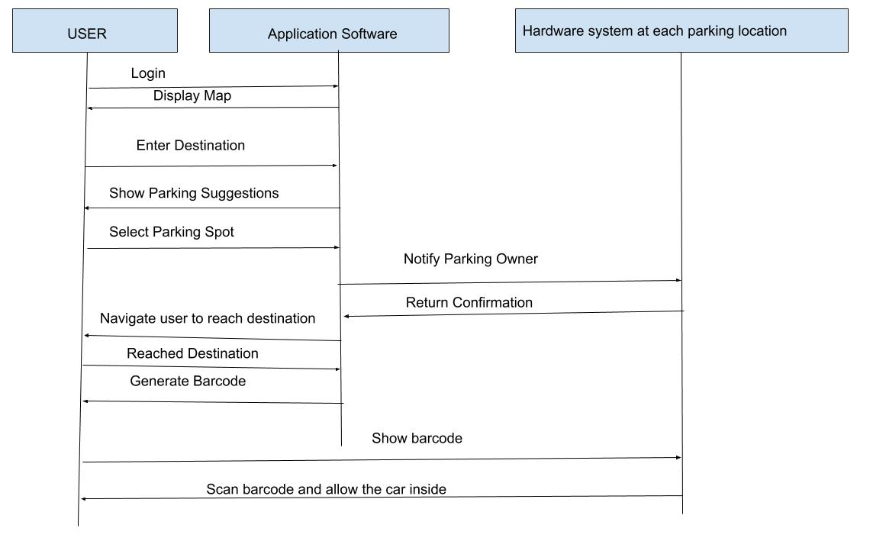
Software (Sequence Diagram): Parking Finder

Slide 6
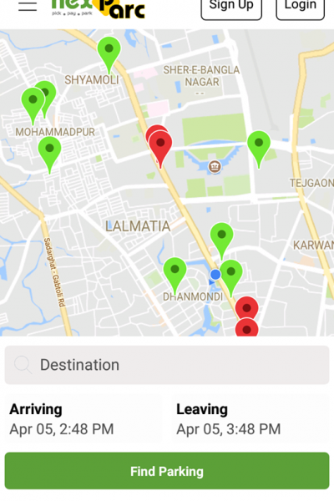
Software Features
Map to find location of available parking space near destination
12/11/2018

Slide 7
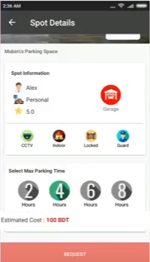
Software Features
Firebase
Payment System

Slide 8
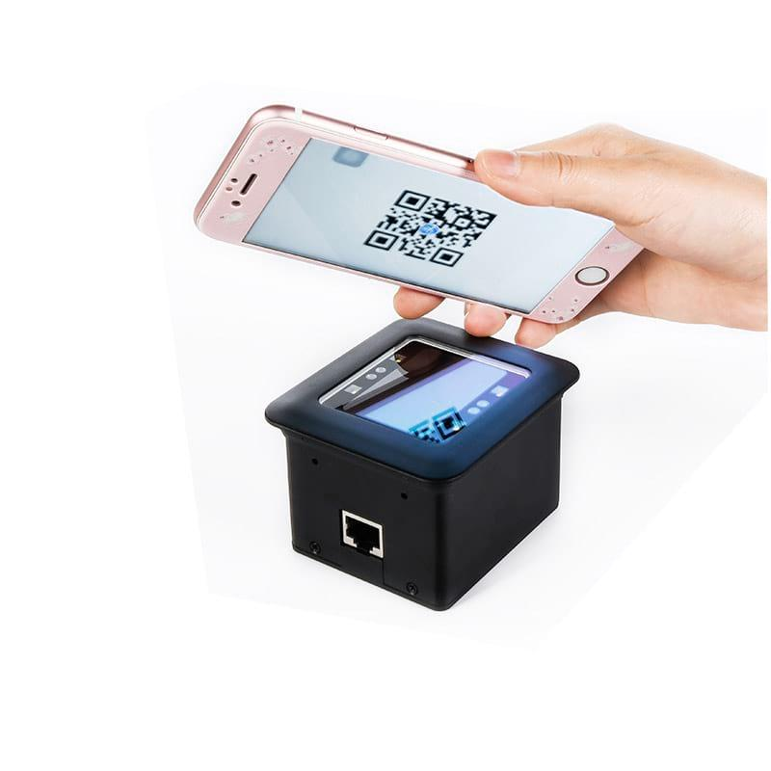
Connecting the App with Hardware
After finding the parking space at given destination, The app will assign a specific parking space
After reaching destination, the app will generate a barcode which will be scanned by the hardware device at the location and approved.

Slide 9
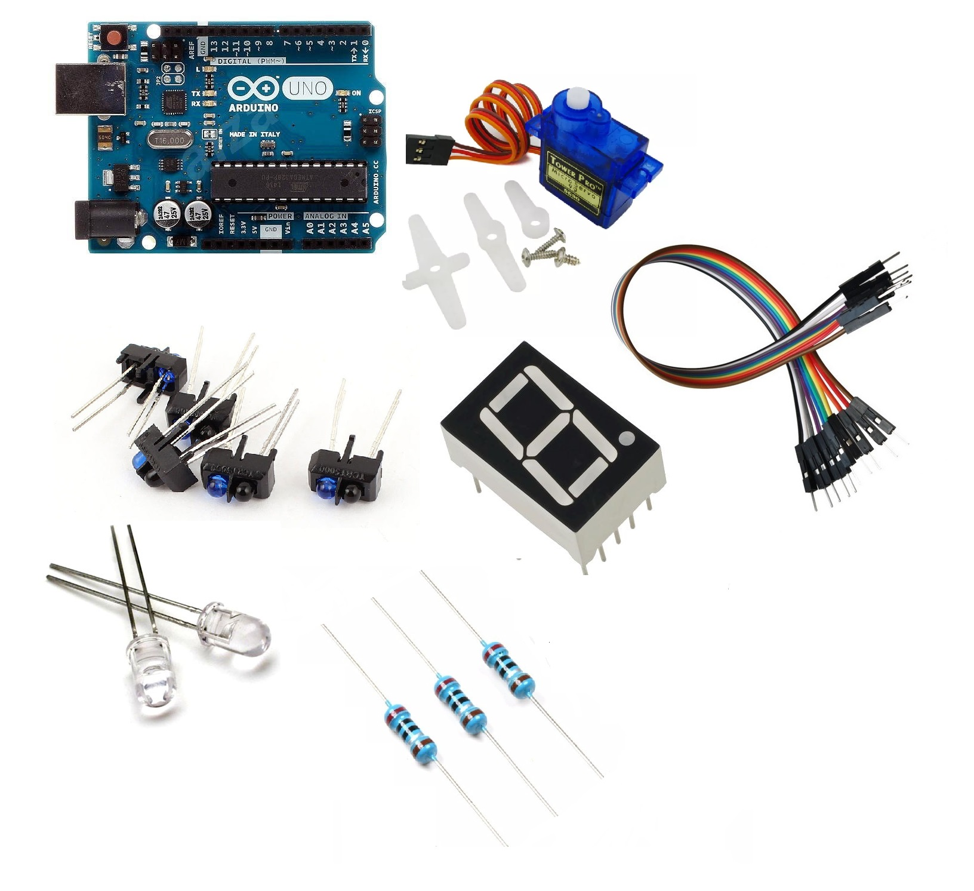
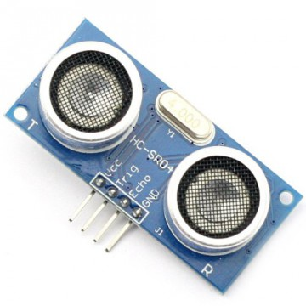
Hardware Components
Arduino Uno Microcontroller
Servo motor
Reflective Optical Sensor
Sonar Sensor
Seven Segment Display
LED
Jumper wire
Bread Board
Notes:
rowshni

Slide 10
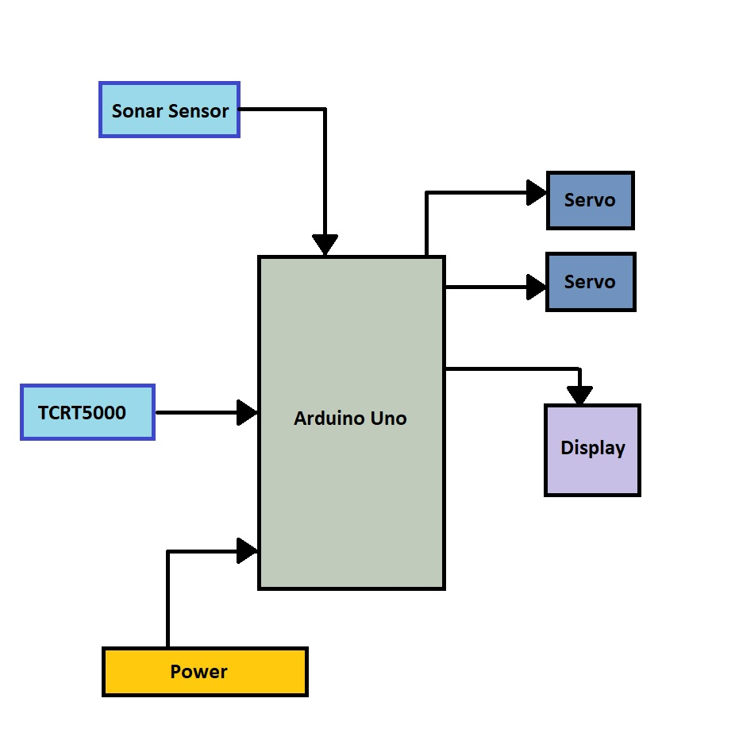
Work flow of our system
Notes:
rowshni

Slide 11
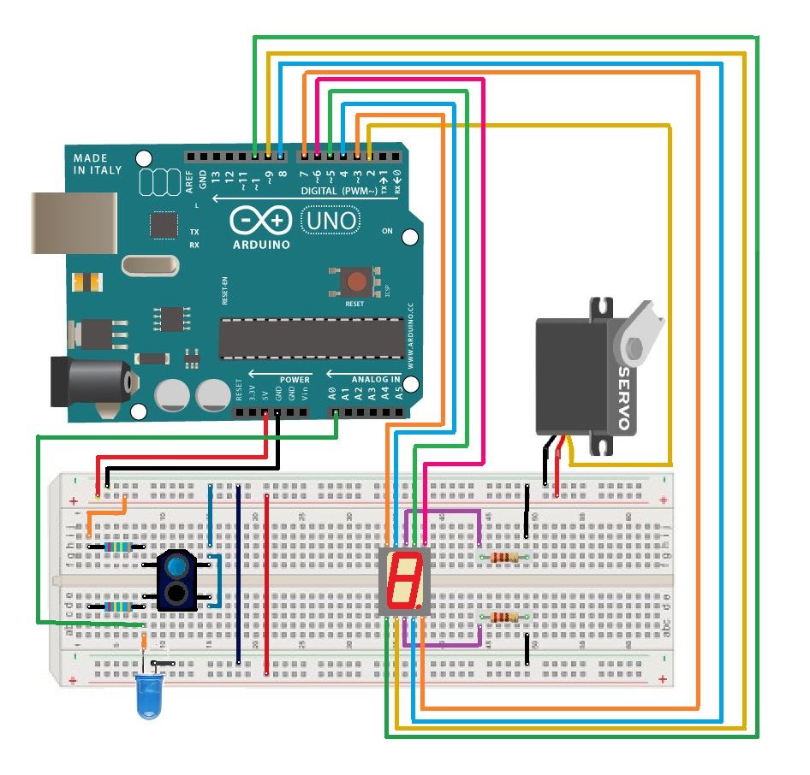
Block Diagram :
Notes:
rowshni

Slide 12
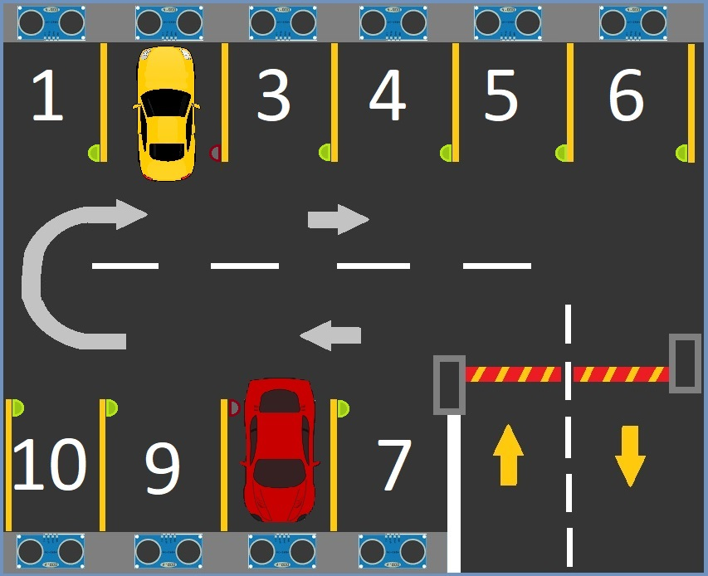
Notes:
rowshni

Slide 13
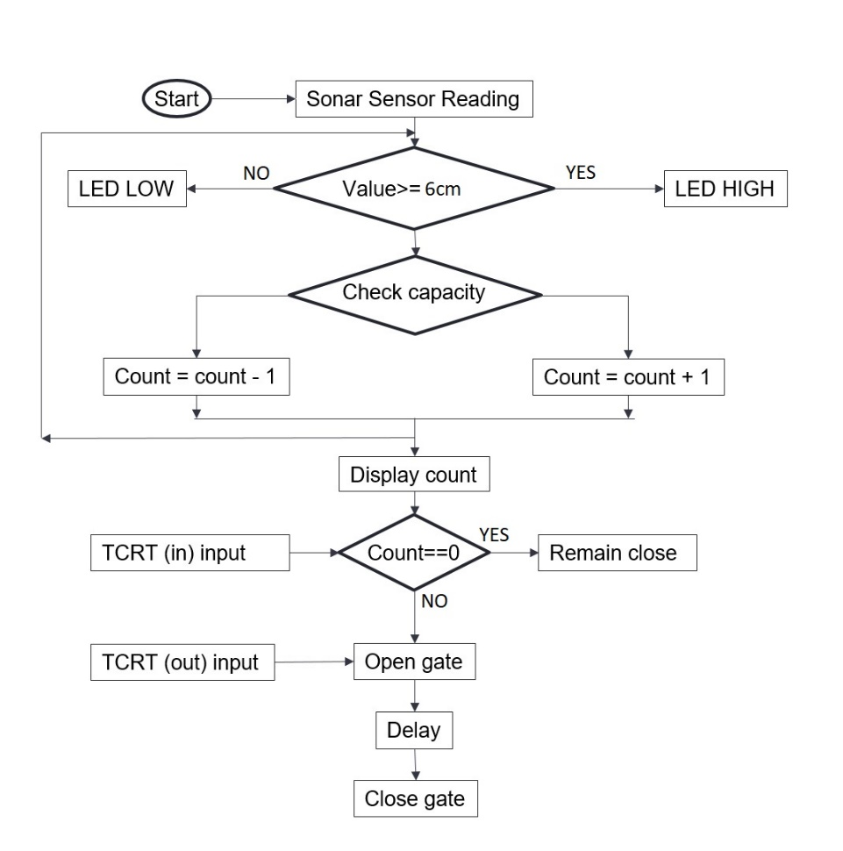
Notes:
rowshni

Slide 14
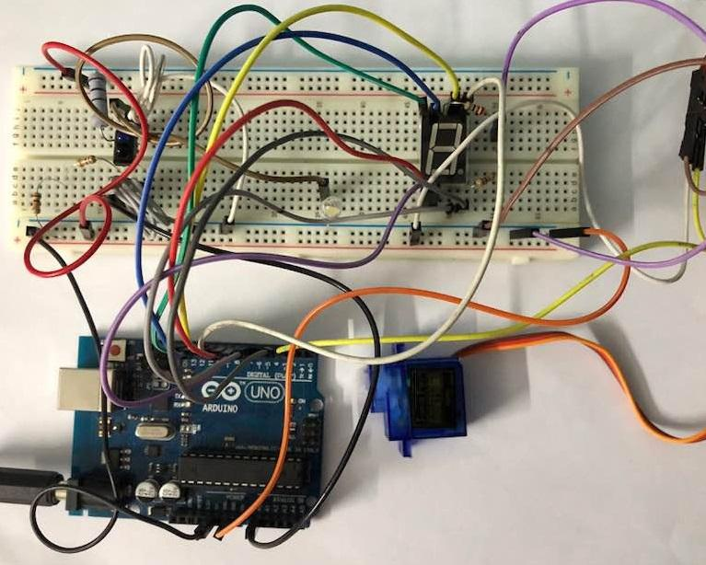
Circuit:
Notes:
rowshni

Slide 15
Market Analysis
According to a research article published by US-based organization Democracy International (DI) on September 22, “Private cars have taken up around 60-65% of available road space for parking in Dhaka city.” – Dhaka Tribune ,Sunday November 11 , 2018
“According to media reports, illegal parking of vehicles occupies as much as 30 percent of the city streets, and naturally, the problem is seriously hampering normal traffic flow in addition to causing nuisance to pedestrians” – 11th February 2018, The Independent

Slide 16
Market Analysis
Target Market
Residential Buildings and Corporate Areas
Hospital and Shopping Complexes
Schools, College and Universities
Market Value around 60-80% ; growing accordingly with the number of commercial, residential or educational institutions

Slide 17
Marketing Strategies
promotional campaigns among target market
advertisement through social media
collaborations with Uber, Pathao etc.
promote through workshops

Slide 18
Thank You !

